Slide 1
For a (system of) mobile robot(s) the fundamental question is:
How to provide a requested service?
Mobile robots: transportation service with e.g. assembly
This amounts to answering a set of more specific questions:
How to distribute the tasks consituting the service to the robots available?
How to communicate between robots in order to monitor the overall service and to react to unforeseen events?
How does one robot carry out its task?
Where is the robot at present? LOCALIZATION
How does the robot build a map about its working environment? MAPPING
How to plan the most efficient path from current location to the location(s) relevant for the service? PLANNING
How to control the motion to follow the planned path? MOTION CONTROL
How to react to unforeseeable events in the environment? COLLISION AVOIDANCE

Slide 2
To provide the service the (system) of robot(s) has a sensory-motor system and intelligence
Sensors, typically
Inertial measurement unit (accelometrs and gyroscopes)
Laser scanner
Camera(s)
Ultrasound proximity sensor
Depth cameras
Measurements of internal states (wheel speeds, joint angles,..), encoders
Motion
Wheels with motors
Joints with motors
”Legs”
Changing the shape of the robot
Intelligence
Computing power
Real time for reflexes
Non-real time for ”thinking”
Algorithms!
Communication
Robot-to-robot
Robotic system to human

Slide 3
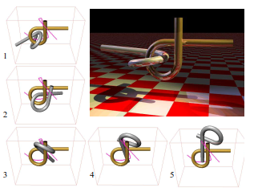
Lecture: Path planning in fully known environment
Risto Ritala
Sept 10 and 24, 2018
IHA-4306 Fundamentals of mobile robotics

Slide 4
Content
Examples of practical cases
Representation of system state – relevant degrees of freedom
Graph as a system model for path planning
Graph = collection of nodes and edges
Generating graph models
Probabilistic roadmaps (PRM)
From geographical maps to graphs
Solving path planning on a graph
Dynamic programming
Dijkstra
A*
Time-expanded graph
Multirobot path planning
Multipath problems – allocation of nodes to a path
Mixed integer programming

Slide 5
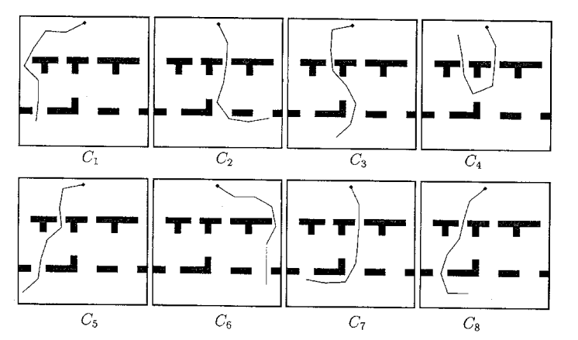
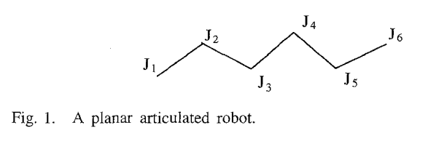
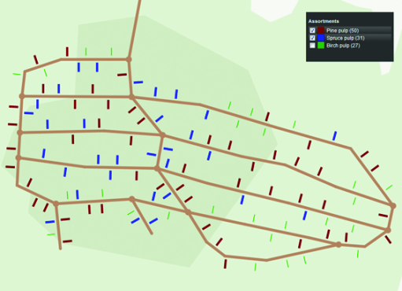
Examples
Warehouse robots at Amazon
Self-driving cars
Cooperative motion
planning
Drone learning path
in forest
Articulated mobile robot
Forest forwarder collecting
harvested woodpiles
Indoors delivery

Slide 6
System state – cornerstone of model-based methods
System state = description such that when completely known at some time instant t, it renders all information about the state at earlier times irrelevant when predicting the system state at later times
Initial conditions for a differential equation
Examples
Pointwise object in 2d with no inertia: x,y –location
Rigid object in 2d with no inertia: x,y -location and orientation angle
Rigid object in 3d with no inertia: x,y,z –location; roll, pitch, yaw –orientation
Rigid object in 3d with inertia: x,y,z –location, x,y,z –speed, roll, pitch, yaw –orientation, roll, pitch, yaw –angular velocity
Articulated mobile robot in 2d with no inertia: x,y -location of one of the endpoints, angles of the joints
N rigid objects in 2d with no inertia: N sets of x,y –location and orientation angle
…
Choosing the state space is somewhat art rather than based on rules, but the list above provides templates to consider.

Slide 7
What is the system state for this problem?
?

Slide 8
Graph as a model for path planning
In principle, path planning provides a continuous trajectory in state space. However, solving for such a trajectory is computationally very expensive.
Find a continuos path from state s₀ to s₁ such that the line integral over the d-dimensional ”potential field V(s)” is minimized
Instead, somehow construct a network of ”roads” and ”junctions” in the state space, and find the ”best route” from current junction to goal junction.
A graph is a collection of nodes and edges
Nodes = ”junctions” = a discrete set of state values
Edges = ”roads” = connections between two nodes, straight or curved
Edges have a direction; e =(start_node,end_node)
Edges or nodes or both may be associated with ”costs” that accumalate once they are traversed
”Best route” between two nodes is the one with least accumulated costs

Slide 9
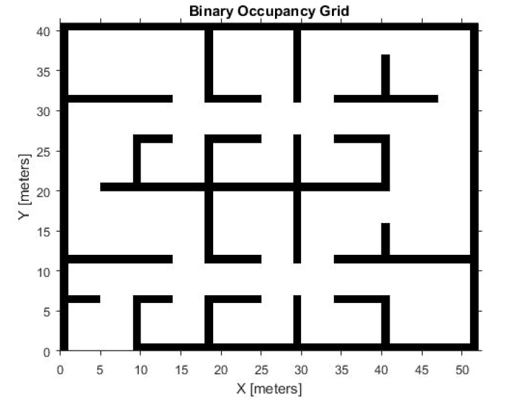
How to construct a graph?
If the orientation is relavant
Heuristically
1
2
3
1out
2in
Left
Down
Right
Up
1in
2out
3out
3in

Slide 10
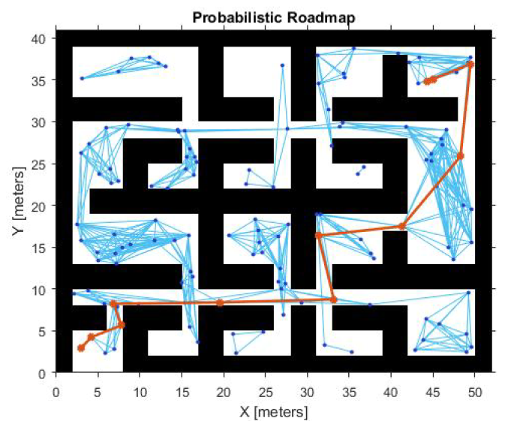
How to construct a graph?
Probabilistic roadmaps
1: generate state values randomly uniformly
distributed in state space
2: discard non-allowed ones (e.g. location
within obstacle)
3: for all remaining state values, check pairwise
if the straight line between the state values
falls entirely into allowed region of the stae space;
if yes, include to the set of edges
In matlab for 2d, no orientation:
planner = robotics.prm(map)
map: occupancy grid (each cell of the map is occupied
or not)
For general case, see: Kavraki et al IEEE Transactions in Robotics and Automation, 12 (4): 566-580 (1996).

Slide 11
How to set the costs?
Application specific
E.g. a cost of traversing an edge is the Euclidean distance between the start and end nodes
”Travel on flat terrain, except for the obstacles”
Uneven terrain taken into account by some penalty function
Gradient of the terrain along the path between two nodes affects the penalty
Allow some unwanted state space values, but make them costly
E.g. in a two robot system the state space value where the robots are at the same node or are traversing the same edge in opposite directions can be made expensive (sometimes slightly easier than removing these from the graph)

Slide 12
NOW, LET US ASSUME WE HAVE THE GRAPH (N,E) OF NODES N AND
EDGES E.
WE TRY TO FIND THE PATH OF EDGES e_{k} FROM NODE n₀ to n_{g}
PATH ={e₁,e₂,… e_{K}} such that
e₁ starts from n₀ (start node)
e_{K} ends at n_{g} (goal node)
for all k = 2,..,K e_{k} starts where e_{k-1} ends (path is connected)
4) the path minimizes
where c(e) is the cost of an edge e

Slide 13
Dynamic programming – principle of optimality
Principle of optimality: If the OPTIMAL PATH FROM NODE n₀ to n_{g} goes via node n_{s} then the correponding section from n_{s} to n_{g} is the OPTIMAL PATH FROM NODE n₀ to n_{g}.
n₀
n₀
n_{s}
optimal
n_{s}
optimal
n_{g}
n_{g}
start(n): set of edges starting from node n
succ(e): end node of edge e
cost of first edge
optimal cost after
first edge

Slide 14
Solving dynamic programming
Note:
For any other n make a guess:
Iterate for all n:
Converges for finite number of nodes
Slow for large number of nodes (linear in number of nodes)
Benefits:
Solution for paths from all nodes to goal node
Works also if c(e) < 0 (edge provides a reward; but then it may be beneficial never to go to goal
Generalizes straight forwardly to non-deterministic travel along the graph

Slide 15
Heuristic path planning on a graph
Dijkstra
A* (”A star”)
Background ideas:
All edge costs are positive and thus optimal paths cannot contain loops
Expand the potential paths to include successors of nodes already included in the search
Bookkepping of nodes in three categories
Dead nodes: the successors of these nodes have already been included in the potential paths (successors are included in dead nodes or active nodes);
best path from start node to dead node has been solved
Active nodes: these nodes have been included in potential paths, but the successors of these nodes are not;
best path from start to an active node is not known, but an upper limit is known
Virgin nodes: have not been included in the potential paths
Continue till the goal node is to be expanded
Difference between Dijkstra and A*: A* tries – with some heuristics – to be a bit more clever which node to expand next.

Slide 16
An expansion step in Dijkstra
(Bidirectional edges)
Red node: starting point
Purple node: goal
Black node: dead
Green node: active
Blue node: virgin
Numbers next to active nodes: current upper
limit for path cost from starting point to the node
Dijkstra: choose among the active nodes
the one with lowest upper limit path cost
10.1
10.8
9.4
9.8
10.5
10.7

Slide 17
An expansion step in Dijkstra
Dijkstra: choose to operate on the node
that has among the active nodes the lowest
path cost = on red square
Find its successors (blue, yellow, green
squares)
If successor is dead (blue) do nothing
If successor is active (yellow), update the cost
to be the minimum of previous cost and the
cost via the operated node (e.g. cost from
red to yellow is 1.0, then yellow has new cost
of 10.4.
If successor is virgin, include in Active nodes
with current cost via the operated node
(e.g cost from red to green is 1.3, then green
has cost 10.7)
10.1
10.8
9.4
9.8
10.5
10.7

Slide 18
An expansion step in Dijkstra
After this step the graph looks like this
Continue till you choose the goal node to
be expanded.
10.1
10.7
10.4
9.8
10.5
10.7

Slide 19
Dijkstra algorithm
Input Graph = (N,E), EdgeCosts, n₀, n_{g}
1: Initialize: Set Dead = empty, Active ={n₀}, CostToGo(n₀)=0
2: n_{c} = node in Active that has smallest CostToGo
3: Succ = successors(n_{c})
4. For each n in Succ do
5: If n not in Union(Active,Dead)
6: Active = Union(Active,n); CostToGo(n) = CostToGo(n_{c}) + EdgeCosts(n_{c},n)
7: Else if n in Active
8: CostToGo(n) = min(CostToGo(n);CostToGo(n_{c}) + EdgeCosts(n_{c},n))
9: End if
10: End do
11: Active=Active\n_{c}; Dead=Union(Dead, n_{c}) % Move n_{c} from Active and put it in Dead
12: If n_{c} = n_{g}, STOP
13: Else: GoTo 2
In MATLAB: e.g. shortestpath

Slide 20
A*
Problem with Dijkstra: it does
not ”know where it is aiming”:
It would make sense to expand the
green on the right rather than the green
on the left even though the latter had
lower CostToCome. The one on right
is ”more in the right direction”.
A*: let h(n,n_{g}) be lower estimate for the cost
from n to n_{g}. Then choose from Active the
node n which has lowest
CostToCome(n) + h(n,n_{g})
Choosing h is heuristic. On often used h is
the Euclidean distance in the absensce of
obstacles.

Slide 21
A* algorithm
Input Graph = (N,E), EdgeCosts, n₀, n_{g}, h(n, n_{g}) < J(n, n_{g}) for all n
1: Initialize: Set Dead = empty, Active ={n₀}, CostToGo(n₀)=0, LowAppCost(n₀) = h(n₀, n_{g})
2: n_{c} = node in Active that has smallest LowAppCost
3: Succ = successors(n_{c})
4. For each n in Succ do
5: If n not in Union(Active,Dead)
6: Active = Union(Active,n); CostToGo(n) = CostToGo(n_{c}) + EdgeCosts(n_{c},n)
7: LowAppCost(n) = CostToGo(n) + h(n, n_{g})
8: Else if n in Active
9: CostToGo(n) = min(CostToGo(n),CostToGo(n_{c}) + EdgeCosts(n_{c},n)
10: LowAppCost(n) = CostToGo(n) + h(n, n_{g})
11: End if
12: End do
13: Active=Active\n_{c}; Dead=Union(Dead, n_{c})
14: If n_{c} = n_{g}, STOP
15: Else: GoTo 2

Slide 22
Time-expanded graph
What if the environment changes, but in a known fashion?
t=1
t=2
Center arrow
disappears at t=2
and reappears
at t=3
(shortcut door
closes)
t=3
t=4

Slide 23
Multi-robot and multipath problems
Multirobot problem
Same area, several robots
State (n₁,..,n_{M}), thus |N|^{M} states (|N| is number of single robot states)
Some states may be explicitly excluded (two or more robots at same node)
Moves are generated based on single robot moves + ”stay at present node”
Synchronous moves: all robots make a move simultaneously
Single-robot moves: only one robot moves at a time
Other asynchronous moves
Some moves may be explicitly excluded (two robots moving between nodes in opposite directions)
Guide the behavior (e.g. no collisions or robots that have reached their destination stay at their destination) with appropriate move costs
Multipath problem
A robot must visit a set of sites (e.g. to collect load) and then a single node (e.g. to unload), and the robots capacity does not allow visiting all the required sites without unloading in between
Two connected problems
Which sites to visit at which tour
In which order the sites are visited at a tour
State: (b₁,..,b_{|N|}), where b_{j} is binary that indicates if node j has ben visited; thus 2^{|N|} states = huge
To solve larger problems, integer programming methods exist; path planning with, e.g. Dijkstra are ineffective

Slide 24
Way to work
Define state representation
Single robot, multiple robots
Discretize state
Form a graph
Time expansion if known temporal changes in the graph
Solve
With A* if only single path needed and you come up with lower estimate h
With Dijkstra if only single path needed and you do not come up with any h
With dynamic programming if you need paths from many nodes to a single goal node
Implement
For this you need motion control to follow the edges; usually also some path smoothing at and close to the nodes

